Slide 1
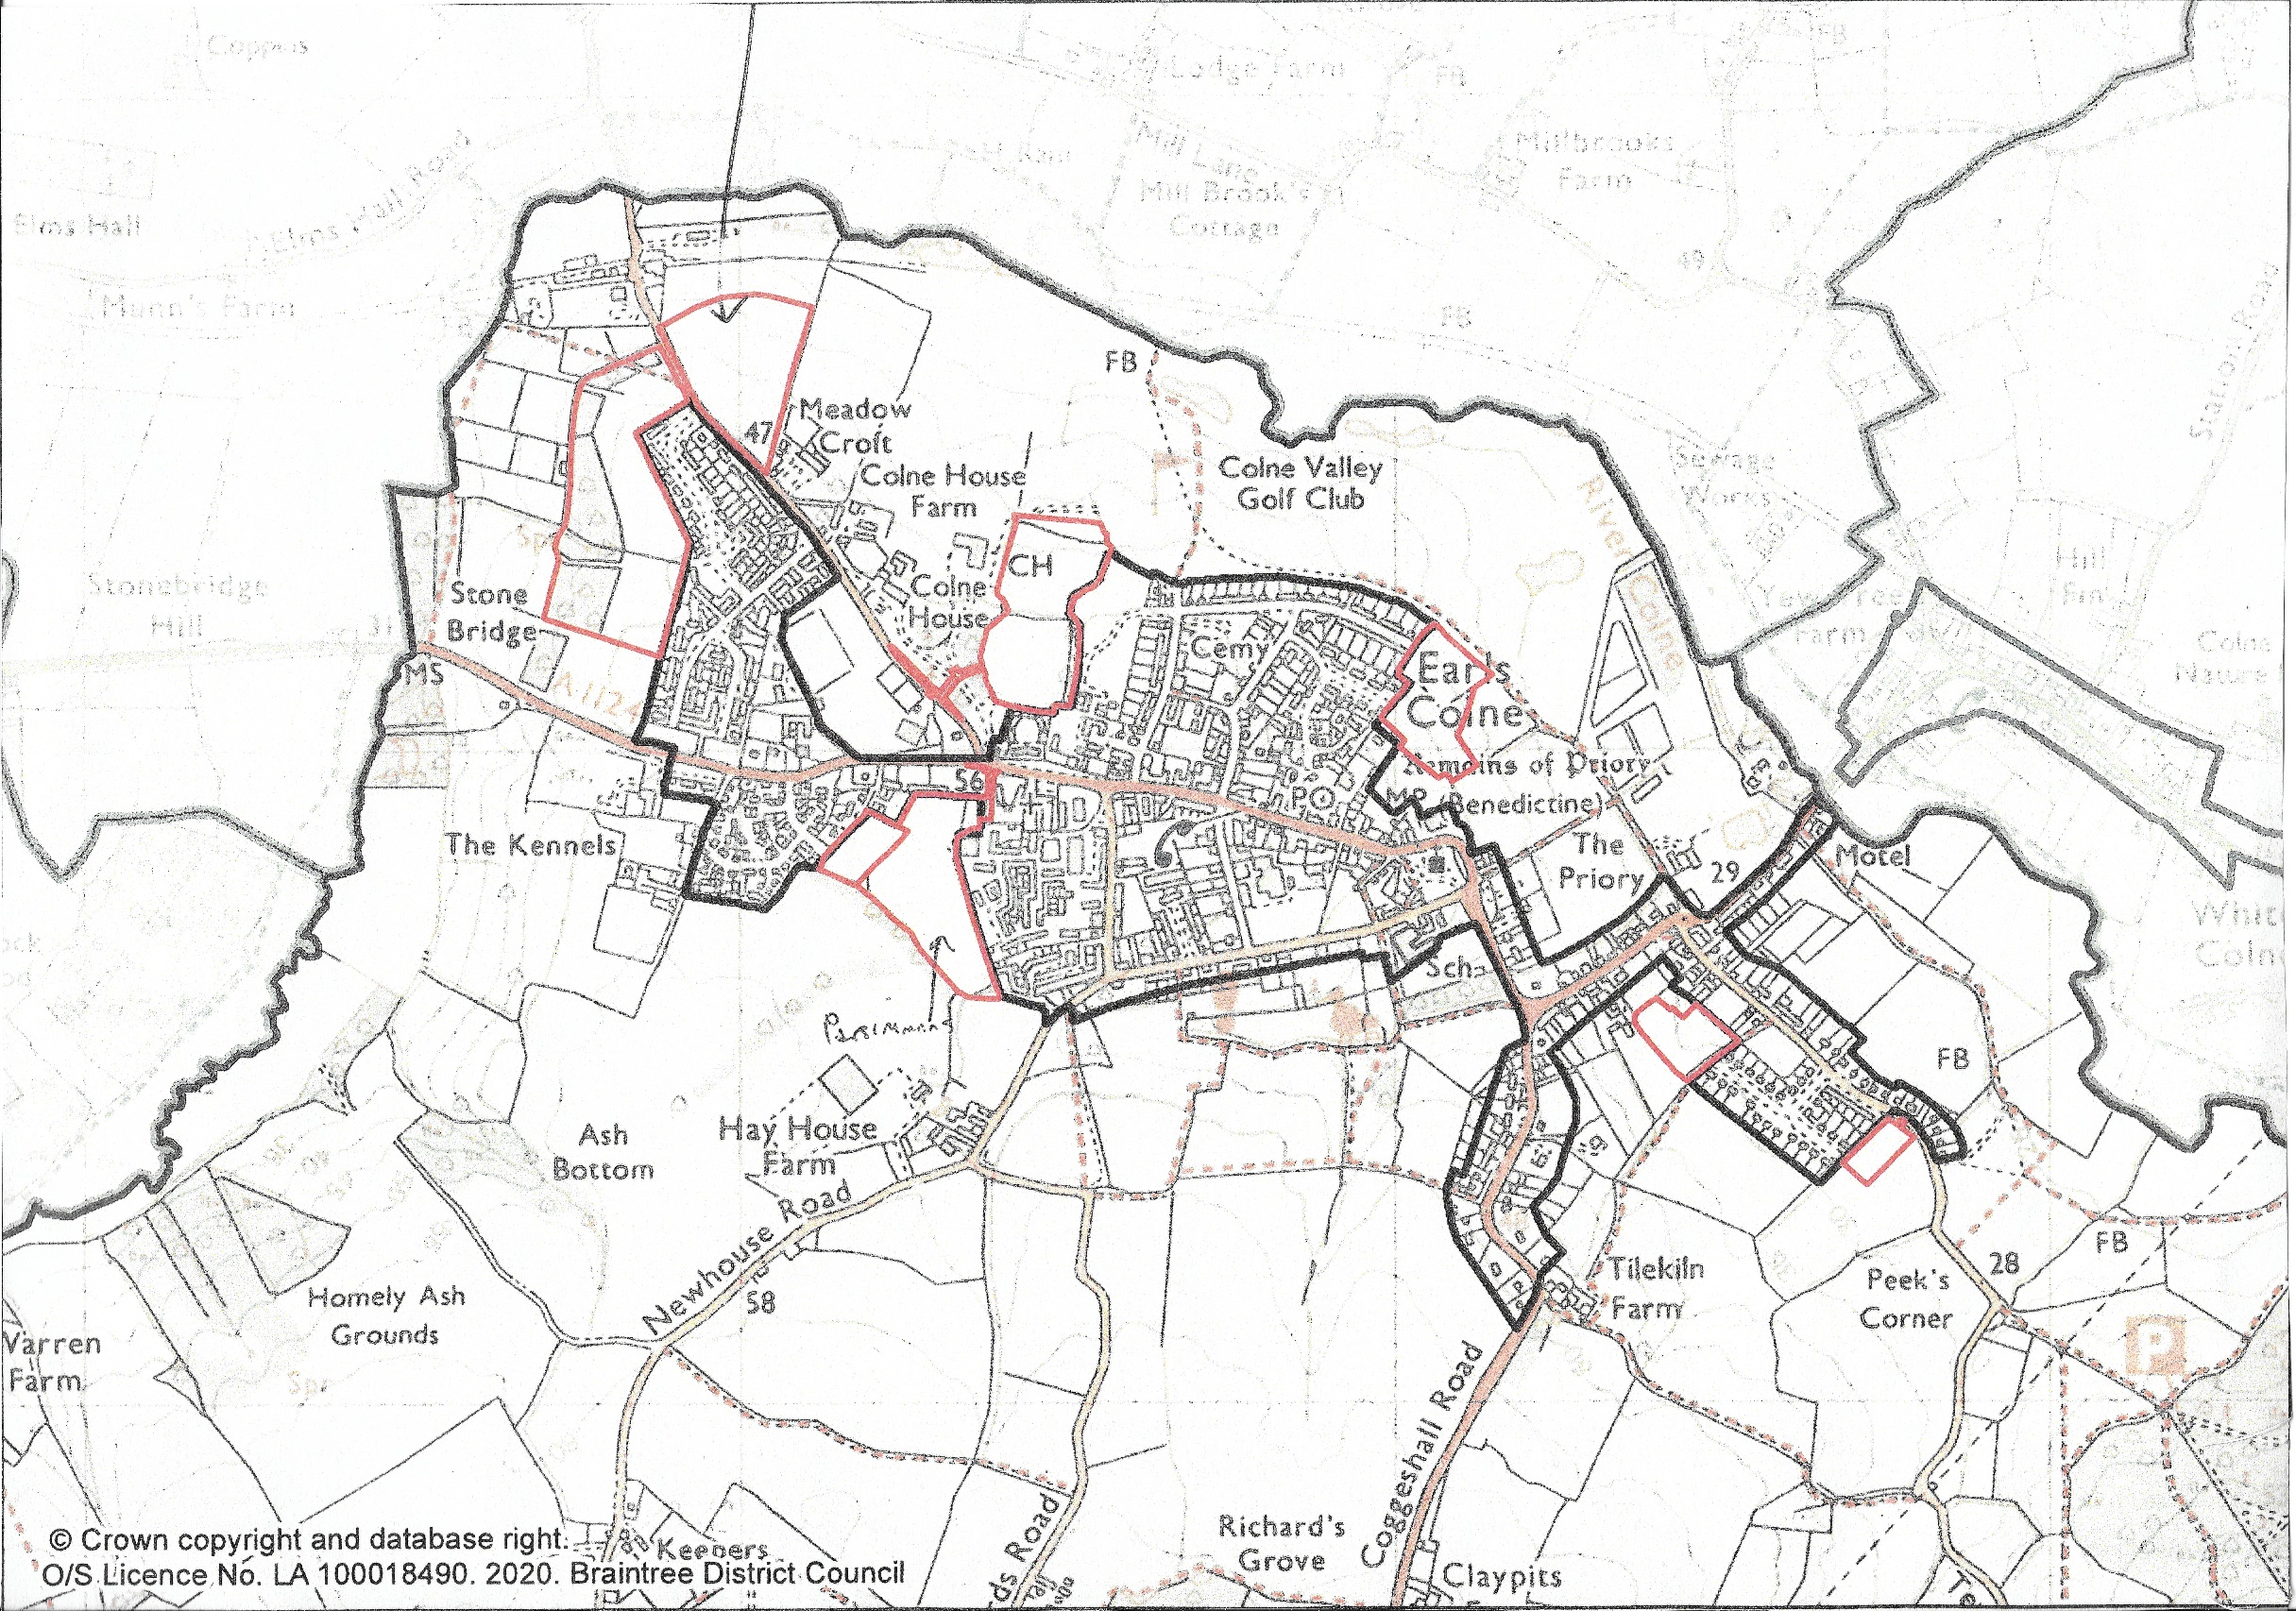
Land West of Station Road
Owner/Developer – Bellway
Number dwellings – 90
Planning Ref: 18/00121
Land North East of Station Road
Owner/Developer – Cala Homes
Number dwellings – 56
Planning Ref: 17/00140
NORTH
Land East of Monks Road
Owner/Developer – Crest Nicholson
Number dwellings – 50
Planning Ref: 16/01475
Earls Colne
Approved and Proposed Developments
July 2021
Land East of Morleys Road
Owner/Developer – Persimmon
Number dwellings – 20
Planning Ref: 17/01769
Land South of Halstead Road
Owner/Developer – Persimmon
Number dwellings – 80
Planning Ref: 15/01580
Land Rear of Tey Road
Owner/Developer – Oakland Country Homes
Number dwellings – 23
Planning Ref: 18/00214

